Slide 1
MongoDB

Slide 2
Questions
&
Answers

Slide 3
Introduction
MongoDB is an open source document database.
MongoDB is written in c++.
It stores data in flexible JSON-like document.

Slide 4
NoSQL
Simplicity of design
Replication
Sharding

Slide 5
Why use MongoDB
Document Oriented Storage
Dynamic
Easy integrated

Slide 6


Advantages of MongoDB
Scalable
Flexible

Slide 7
Disadvantages of MongoDB
Not useful for highly transaction application
Limited data size

Slide 8
Considerations while designing Schema in MongoDB
Design your schema according to user requirements.
Combine objects into one document if you will use them together. Otherwise separate them (but make sure there should not be need of joins).
Duplicate the data (but limited) because disk space is cheap as compare to compute time.
Do joins while write, not on read.
Optimize your schema for most frequent use cases.
Do complex aggregation in the schema.

Slide 9
Data models in mongodb
MongoDB provides two types of data models: — Embedded data model and
— Normalized data model.
Based on the requirement, you
can use either of the models
while preparing your document.

Slide 10
Embedded data model
In this model, you can have (embed) all the related data in a single document, it is also known as de-normalized data model.
For example, assume we are getting the details of employees in three different documents namely, Personal_details, Contact and, Address, you can embed all the three documents in a single one as shown below −

Slide 11
{
_id: ,
Emp_ID:”1”
Personal_details:{first_name:”ranu”,Last_name:”sahu”},
contact:{e_mail:”xyz@gmail.com”,phone:”123456789”},
address:{city: “hydrabad”,area:”madapur”}
}

Slide 12
Normalized data model
In this model, you can refer the sub documents in the original document, using references. For example, you can re-write the above document in the normalized model as:
Employee:{
_id: <ObjectId>, Emp_ID:”1”
}
Personal_details:
{
_id:<ObjectId102>, empDocID:”ObjectID101”, first_name:”ranu”, Last_name:”sahu”
},

Slide 13
Continued………………………
contact:
{
_id:<ObjectId103>,empDocID:”ObjectId101”,e_mail:”xyz@gmail.com”,phone:”123456789”
},
address:
{
_id:<Object104>,empDocID:”ObjectId101”,city: “hydrabad”,area:”madapur”
}

Slide 14
Indexing
Defining indexes are important for faster and efficient searching of documents in a collection.
Indexes can be created by using the createIndex method. Indexes can be created on just one field or multiple field values.
db.collectionname.createIndex( { key:value } )
Indexes can be found by using the getIndexes method.
db.collectionname.getIndex( )
Indexes can be removed by using the dropIndex for single indexes or dropIndexes for dropping all indexes.

Slide 15
The indexing has various attributes:
Access Types: This refers to the type of access such as value based search, range access, etc.
Access Time: It refers to the time needed to find particular data element or set of elements.
Insertion Time: It refers to the time taken to find the appropriate space and insert a new data.
Deletion Time: Time taken to find an item and delete it as well as update the index structure.
Space Overhead: It refers to the additional space required by the index.

Slide 16
There are primarily three methods of indexing:
Clustered Indexing - When more than two records are stored in the same file these types of storing known as cluster indexing.
Non-Clustered or Secondary Indexing - A non clustered index just tells us where the data lies, i.e. it gives us a list of virtual pointers or references to the location where the data is actually stored. Data is not physically stored in the order of the index.
Multilevel Indexing - The multilevel indexing segregates the main block into various smaller blocks so that the same can stored in a single block. The outer blocks are divided into inner blocks which in turn are pointed to the data blocks. This can be easily stored in the main memory with fewer overheads.

Slide 17
Limitation of indexing
Extra Overhead :- Every index occupies some space as well as causes an overhead on each insert, update and delete. So if you rarely use your collection for read operations, it makes sense not to use indexes.
RAM Usage :- Since indexes are stored in RAM, you should make sure that the total size of the index does not exceed the RAM limit. If the total size increases the RAM size, it will start deleting some indexes, causing performance loss.
Query Limitations :-Indexing can't be used in queries which use −
Regular expressions or negation operators like $nin, $not, etc.
Arithmetic operators like $mod, etc.
$where clause

Slide 18
Continued…………….
Index Key Limits :- Starting from version 2.6, MongoDB will not create an index if the value of existing index field exceeds the index key limit.
Inserting Documents Exceeding Index Key Limit :-MongoDB will not insert any document into an indexed collection if the indexed field value of this document exceeds the index key limit. Same is the case with mongorestore and mongoimport utilities.
Maximum Ranges :-
A collection cannot have more than 64 indexes.
The length of the index name cannot be longer than 125 characters.
A compound index can have maximum 31 fields indexed.

Slide 19
Relationship in MongoDB
// patron document
{
_id: "joe",
name: "Joe Bookreader"
}
Relationships in MongoDB represent how various documents are logically related to each other.
Relationships can be modeled via Embedded and Referenced approaches. Such relationships can be either 1:1, 1:N, N:1 or N:N.
// address document
{
street: "123 Fake Street",
city: "Faketon",
state: "MA",
zip: "12345"
}

Slide 20
One to One Relationship
Embedded Approach
Referenced Approach
{
_id: "joe",
name: "Joe Bookreader",
address: {
street: "123 Fake Street",
city: "Faketon",
state: "MA",
zip: "12345"
}
}
{
patron_id: "joe", // reference to patron document
street: "123 Fake Street",
city: "Faketon",
state: "MA",
zip: "12345“
}

Slide 21
One to Many Relationship
Embedded Approach
Referenced Approach
{
title: "MongoDB: The Definitive Guide",
author: [ "Kristina Chodorow", "Mike Dirolf" ],
published_date: ISODate("2010-09-24"),
pages: 216,
language: "English",
publisher: {
name: "O'Reillly Media”, founded: 1980, location: "CA
} }
{
_id: "oreilly“,
name: "O'Reilly Media, founded: 1980, location: "CA“
}
{
_id: 123456789, title: "MongoDB: The Definitive Guide", author: [ "Kristina Chodorow", "Mike Dirolf" ], published_date: ISODate("2010-09-24), pages: 216, language: "English", publisher_id: "oreilly“
}
{
_id: 234567890, title: "50 Tips and Tricks for MongoDB Developer", author: "Kristina Chodorow", published_date: ISODate("2011-05-06"), pages: 68, language: "English", publisher_id: "oreilly“
}
{
title: "50 Tips and Tricks for MongoDB Developer",
author: "Kristina Chodorow",
published_date: ISODate("2011-05-06"),
pages: 68,
language: "English",
publisher: {
name: "O'Reilly Media", founded: 1980, location: "CA"
} }

Slide 22
MongoDB - Database References
Manual references where you save the _id field of one document in another document as a reference. Then your application can run a second query to return the related data. These references are simple and sufficient for most use cases.
To implement a normalized database structure in MongoDB, we use the concept of Referenced Relationships also referred to as Manual References in which we manually store the referenced document's id inside other document. However, in cases where a document contains references from different collections, we can use MongoDB DBRefs.
DBRefs are references from one document to another using the value of the first document’s _id field, collection name, and, optionally, its database name. By including these names, DBRefs allow documents located in multiple collections to be more easily linked with documents from a single collection.

Slide 23
Format
DBRefs have the following fields:
$ref
The $ref field holds the name of the collection where the referenced document resides.
$id
The $id field contains the value of the _id field in the referenced document.
$db
Optional.

Slide 24
{
"_id":ObjectId("53402597d852426020000002"),
"address":
{
"$ref": "address_home",
"$id": ObjectId("534009e4d852427820000002"),
"$db": "techment“
},
"contact": "987654321", "dob": "01-01-1991", "name": "Tom Benzamin“
}
EXAMPLE
//Collection Name : “address_home” Database Name : “techment”
{
"_id" : ObjectId("534009e4d852427820000002"),
"building" : "22 A, Indiana Apt",
"pincode" : 123456,
"city" : "Los Angeles",
"state" : "California“
}

Slide 25
An ObjectId is a 12-byte BSON type having the following structure −
The first 4 bytes representing the seconds since the unix epoch
The next 3 bytes are the machine identifier
The next 2 bytes consists of process id
The last 3 bytes are a random counter value
ObjectId
MongoDB uses ObjectIds as the default value of _id field of each document, which is generated while the creation of any document. The complex combination of ObjectId makes all the _id fields unique.

Slide 26
Creating New ObjectId
To generate a new ObjectId use the following code −
> newObjectId = ObjectId()
The above statement returned the following uniquely generated id −
ObjectId("5349b4ddd2781d08c09890f3")
Instead of MongoDB generating the ObjectId, you can also provide a 12-byte id −
>myObjectId = ObjectId("5349b4ddd2781d08c09890f4")

Slide 27
Sharding
Sharding is the process of storing data records across multiple machines and it is MongoDB's approach to meeting the demands of data growth. As the size of the data increases, a single machine may not be sufficient to store the data nor provide an acceptable read and write throughput. Sharding solves the problem with horizontal scaling.

Slide 28
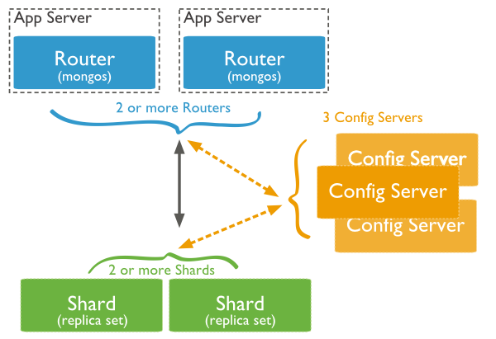
Sharding : Diagram

Slide 29
Replication
Replication is referred to the process of ensuring that the same data is available on more than one Mongo DB Server. This is sometimes required for the purpose of increasing data availability.
Because if your main MongoDB Server goes down for any reason, there will be no access to the data. But if you had the data replicated to another server at regular intervals, you will be able to access the data from another server even if the primary server fails.

Slide 30
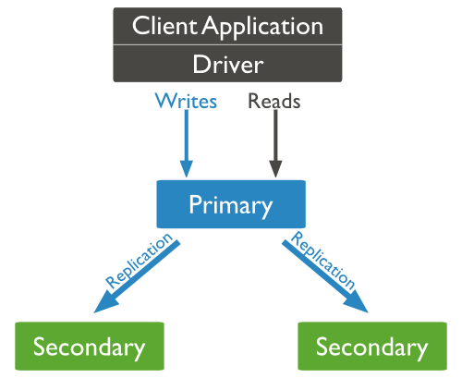
Replication : Diagram

Slide 31
Transaction VS Atomic Operation
MongoDB does not support multi-document atomic transactions. However, it does provide atomic operations on a single document.
The recommended approach to maintain atomicity would be to keep all the related information, which is frequently updated together in a single document using embedded documents.

Slide 32
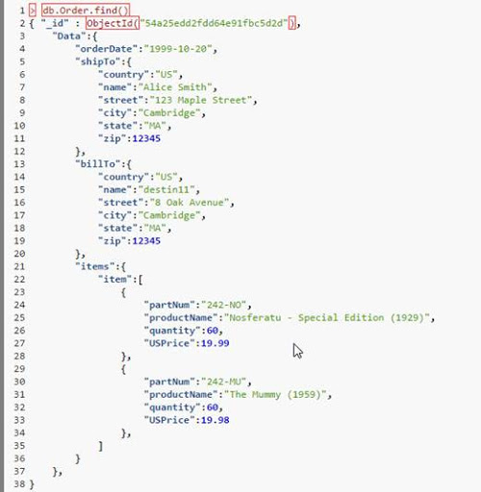
Atomic : Diagram

Slide 33
Presented By :
GROUP 1
Kumar Saurav
Aman Yadav
Harshita
Zahra Sakti

Slide 34
ThankYou

